Slide 1
Stephen Ngan
JAS & Associates
保健營養巿場推廣部主管
Head of Healthcare Marketing, JAS & Associates

Slide 2
Wellmune™ WGP的威力 The Power of Wellmune™ WGP

Slide 3
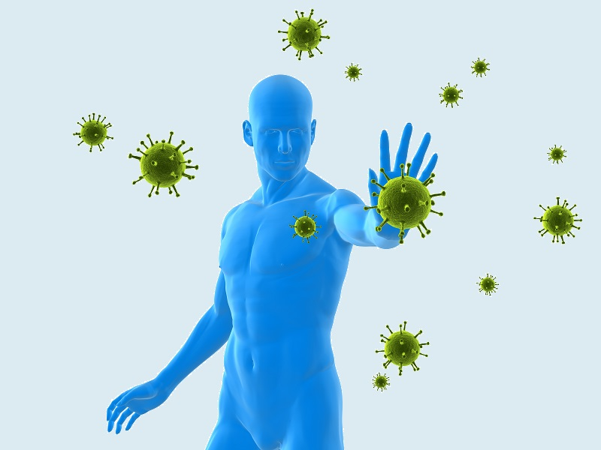
基本免疫學 Basic Immunology
免疫系統是人體中最複雜的系統之一
The immune system is one of the most complex systems of the human body

Slide 4
免疫系統的兩大功能：
識別 – 找出和標識
抵抗 – 擊退或消滅
Two basic functions of immune system:
Recognition – locate and identify the challenge
Defence – repel or destroy the challenge

Slide 5
免疫系統大體可以分為先天免疫系統和後天免疫系統兩部分:
先天性免疫
後天性免疫
The immune system can be broadly segregated into two parts:
Innate immune system
Adaptive immune system

Slide 6
先天性免疫（與生俱來的），是由於其具有的一系列無需特定訓練即可識別和摧毀感染源的能力。
The ‘innate’ (meaning: “present from birth”) part of the immune system is so-called because it has a number of set strategies for recognizing and destroying infections, without needing to be trained to identify them.

Slide 8
而後天性免疫則不能即時對感染做出應答，因為其需要時間（學習）適應並且識別外來感染物質。一旦後天免疫系統通過了這個“學習”過程之後，將會變得非常高效並且可以記憶曾入侵過體內的特異致病原。
The adaptive immune system isn’t able to respond instantly to infections, as it needs time to adapt (or learn) to recognize them. Once it has learned, however, it is extremely effective and is also able to remember particular pathogens that have previously infected the body.

Slide 9
抗體的濃度
第一次疫苗接種或感染
第二次疫苗接種或感染
時間(日子)

Slide 10
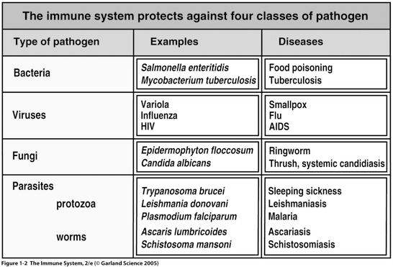
免疫系統抵禦的4類病原 The immune system protects against four classed of pathogen
病原
例子
疾病
細菌
病毒
真菌
寄生蟲
原蟲
蠕蟲

Slide 11
免疫學 101 Immunology 101
先天
後天

Slide 12
Innate Immunity
Adaptive Immunity
Arrest and destroy bacteria, virus and cancer cell
After infection of virus, it produces antibodies to enhance the recovering ability.
Natural Killer cells
Macrophages
T cells
B cells

Slide 13
99%的疾病都是免疫系統失調所造成的
99% of all diseases are caused by the immune system disorders.

Slide 14
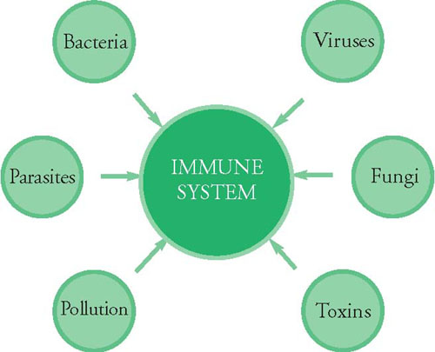
免疫系統下降：易得各種各類的傳染病
Impaired immune system: easy to get all kinds of infectious diseases
細菌
病毒
寄生蟲
真菌
污染
毒素

Slide 15
薄弱的細胞免疫功能
增加癌症的風險
嚴重感染 – 敗血症
慢性感染 – 慢性炎症風險
Poor cell-mediated immune function
Increased Cancer risk
Overwhelming infection – Sepsis
Chronic infections – Risk of chronic inflammation

Slide 16
異常的免疫反應
– 環境 – 防過敏，哮喘等
– 自身免疫性疾病 – 1型糖尿病，甲狀腺疾病，克隆氏病
Abnormal Immune Response
– Environment - allergy, asthma, etc.
– Auto-immune diseases – Type 1 Diabetes, Thyroid disease, Crohn’s disease

Slide 17
營養會否影響免疫功能？
Does nutrition affect immune function?

Slide 18
脂肪、油、糖類 吃最少
脂肪(天然成份及添加)
糖份(添加)
牛奶 、 乳 酪及芝 士類
2-3份
肉、家禽、魚、豆、蛋、堅果類
2-3份
蔬菜類
3-5份
水果類
2-4份
五穀類
6-11份

Slide 19
穀物
蔬菜
水果
牛奶
肉及豆類

Slide 20
每日運動及體重管理

Slide 21
Wellmune™
Wellmune™是一種天然酵母的β葡聚醣(複合碳水化合物)
取自一種名叫Saccharomyces cerevisiae的獨特酵母
Wellmune™可支援免疫細胞
Wellmune™ is a natural yeast beta glucan (complex carbohydrates)
Derived from a proprietary strain of yeast, Saccharomyces cerevisiae.
Wellmune™ works to support immune cells

Slide 22
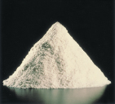
麵包酵母細胞解剖
缺少的鍵合

Slide 23
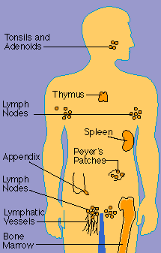
如何運作? How it Works?
當Wellmune™被吸收時，免疫細胞會從消化道把Wellmune™帶到身體上的免疫器官。在那裡，稱為巨噬細胞的免疫細胞，把Wellmune™消化成較小的碎片，並在數天時間內慢慢釋放它們。當釋放Wellmune™碎片時，碎片會和嗜中性粒細胞上的特定受體（CR3）結合，而身體內最多的免疫細胞就是嗜中性粒細胞。
When Wellmune™ is ingested, immune cells in the gastrointestinal tract take it up and transport it to the immune organs throughout the body. While there, immune cells, called macrophages, digest the Wellmune™ into smaller fragments and slowly release them over a number of days. As they are released, the fragments bind to specific receptors (CR3) on neutrophils, which are the most abundant immune cells in the body.

Slide 24
Wellmune™可支援在體內的嗜中性粒細胞和促進細胞的正常活動，包括促進免疫系統健康。它還支援負責吞噬和消滅外來細菌工作的吞噬細胞，從而促進免疫系統的健康。
Wellmune™ supports the activity of the neutrophils and prime them for their normal activity in the body, including promoting immune health. It also supports the activity of phagocytic cells, which engulf and destroy foreign bodies, thus promoting immune health.

Slide 25
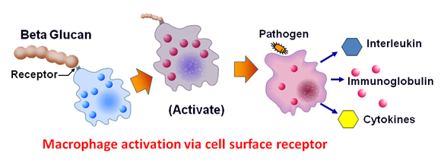
與其他免疫調節物質不同的是，Wellmune™ 不會過度刺激免疫系統。其它的免疫促進成分很可能會對人體造成有害的副作用。
Unlike other immune health ingredients, Wellmune™ boosts immune function without over stimulating the immune system.
β-葡聚醣
病原
受體
活化
巨噬細胞孑經細胞表面受體的活化
Macrophage activation via cell surface receptor

Slide 26
有研究支持嗎？
Do studies back up the claims?

Slide 27
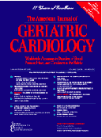
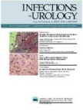
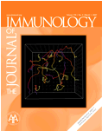
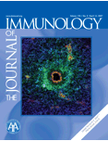
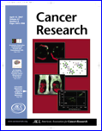
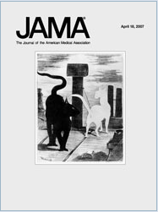
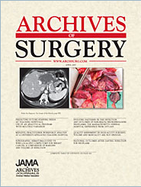
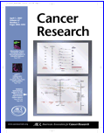
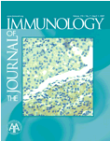
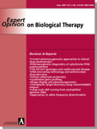
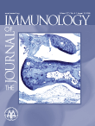
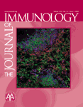
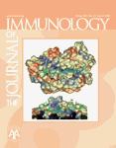
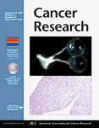
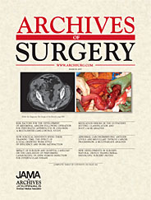
研究 Research

Slide 28
“感冒和流感”: 一個懸而未決的問題 “Cold and Flu”: An unsolved Problem
牽連超過400病毒
季節轉變
沒效的疫苗策略
免疫系統的作用？
Over 400 viruses implicated
Seasonal shift and drift
No effective vaccine strategy
Role of innate immune system?

Slide 29
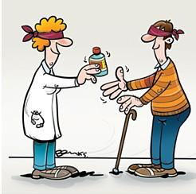
一項雙盲，安慰劑對照研究…
A Double-Blind, Placebo-Controlled Study
J Diet Suppl. 2013 Sep;10(3):171-83. doi: 10.3109/19390211.2013.820248. Epub 2013 Aug 9.

Slide 30
324傷風/感冒患者(馬拉松跑手)
Wellmune™組
安慰劑組
324 subjects with cold/flu (marathon runners)
Wellumne™ group
Placebo group

Slide 31
傷風或感冒症狀
安慰劑組=241總天數
Wellmune™組=198總天數
P = 0.039
COLD and FLU SYMPTOMS
Placebo group = 241 Days
Wellmune™ group = 198 Days
P = 0.039

Slide 32
組別
安慰劑
活躍
咳嗽
流鼻涕
打噴嚏
喉嚨痛
對比昨天的傷風情況
鼻塞
思路清晰
良好睡眠
頭部充血

Slide 33
結果：傷風或感冒症狀減輕
Results: relieve cold and flu symptoms

Slide 34
安全性 Safety
動物毒性研究，每日劑量範圍從0到1000倍
發表急性和慢性毒性研究
人體研究達每日建議劑量60倍
Published animal toxicity studies with doses ranging from 0 to 1,000 times recommended daily dose
Published acute and chronic toxicity studies
Published human studies with doses up to 60 times recommended daily dose

Slide 35
維他命C Vitamin C
傷口癒合，抗感染
抗氧化作用
缺乏症：壞血病（牙齦出血）
促進膠原蛋白的形成，維持細胞排列的緊密性，參與體內氧化還原反應，促進鐵的吸收。
Wound healing, resistance to infections.
Anti-oxidative action
Deficiency: scurvy (bleeding gums)
Helps with the formation of Collagen. Maintains the tightness of the cell arrangement. Maintains the growth of connective tissue, bones and teeth.

Slide 36
鋅 Zinc
支持大約300種不同的酵素反應
體內超過90％的鋅均存儲在骨骼和肌肉內，但鋅也存在於絕大多數的身體組織內
支持免疫系統健康的關鍵
Supports approximately 300 different enzyme reactions
More than 90 percent of the body’s zinc is stored in the bones and muscles, but zinc is also found in virtually all body tissues.
Supports immune health

